Slide 1
Literature Review Structural Characterization of a Heparan Sulfate Pentamer Interacting with LAR-Ig1-2 Qi Gao, Jeong-Yeh Yang, Kelley W. Moreman, John G. Flanagan, James H. Prestegard
Gordon Chalmers
Department of Computer Science
Complex Carbohydrate Research Center

Slide 2
Outline
Background of LAR
Goal of research
Types of experiments
Results
Many of these pictures are from the thesis defense of Qi Gao

Slide 3
LAR
leukocyte common antigen-related protein
receptor protein tyrosine phosphatase
heparan sulfate proteoglycans and chondroitin sulfate interact with LAR and the complex is important for axon growth and synaptic function
fondaparinux (arixtra is synthetic name) is a fragment of heparan sulfate and is used as a simple model of the ligand
LAR has not been studied extensively structurally

Slide 4
LAR-GAG Interaction Affects Axon Extension
Chondroitin Sulfate
Axon growth is inhibited.
Heparan Sulfate
Neuronal extension is promoted.
3
Notes:
LAR, or leukocyte common antigen-related protein, is one of the type IIa receptor protein tyrosine phosphatases (RPTPs). LAR regulates diverse biological events, such as axonal guidance and outgrowth during neural development ⁶², synaptic organization⁶³, cell proliferation⁶⁴ and immune response⁶⁵. Heparan sulfate proteoglycans (HSPGs) and chondroitin sulfate proteoglycans (CSPGs) can both interact with LAR and modulate RPTP signaling at neuronal growth cones while giving opposite results ⁶¹. HSPGs complexing with LAR result in proteins clustering and promote neuron extension to the post synapse and interaction with postsynaptic proteins such as TrkC receptor protein tyrosine kinase. Contrarily, CSPGs complexing with LAR disrupt protein clustering, and lead to an inhibition of the neural growth and regeneration.
<number>

Slide 5
LAR
Protein-tyrosine-phosphatases (PTPs), in conjunction with protein-tyrosine kinases, play essential regulatory roles in diverse cellular activities by modulating the phosphorylation state of target proteins.
Leukocyte common antigen-related (LAR) protein is a widely expressed receptor-type protein-tyrosine-phosphatase that is implicated in the regulation of intracellular signaling triggered by both cell adhesion and peptide growth factors.
Gene for LAR is 1p32 in human chromosome
RPTP’s have 3 immunoglobulin (Ig) domains, 9 fibronectin units, a transmembrane helix, 2 intracellular phosphotyrosine specific phosphatase domains
This length of the RPTP makes the exocellular protein extend
In this study, the first Ig domains, Ig-1 and Ig-2, are used

Slide 6
Paper about how PTP’s and CSPG’s regulate axon regeneration
Modulation of the proteoglycan receptor PTPs promotes recovery after spinal cord injury
Bradley T. Lang1, Jared M. Cregg1, Marc A. DePaul1, Amanda P. Tran1, Kui Xu 2, Scott M. Dyck3, Kathryn M. Madalena1, Benjamin P. Brown4, Yi-Lan Weng5, Shuxin Li6, Soheila Karimi-Abdolrezaee3, Sarah A. Busch1, Yingjie Shen2 & Jerry Silver1
- eliminate somewhat chondroitin sulfate and populate with heparan sulfate

Slide 7
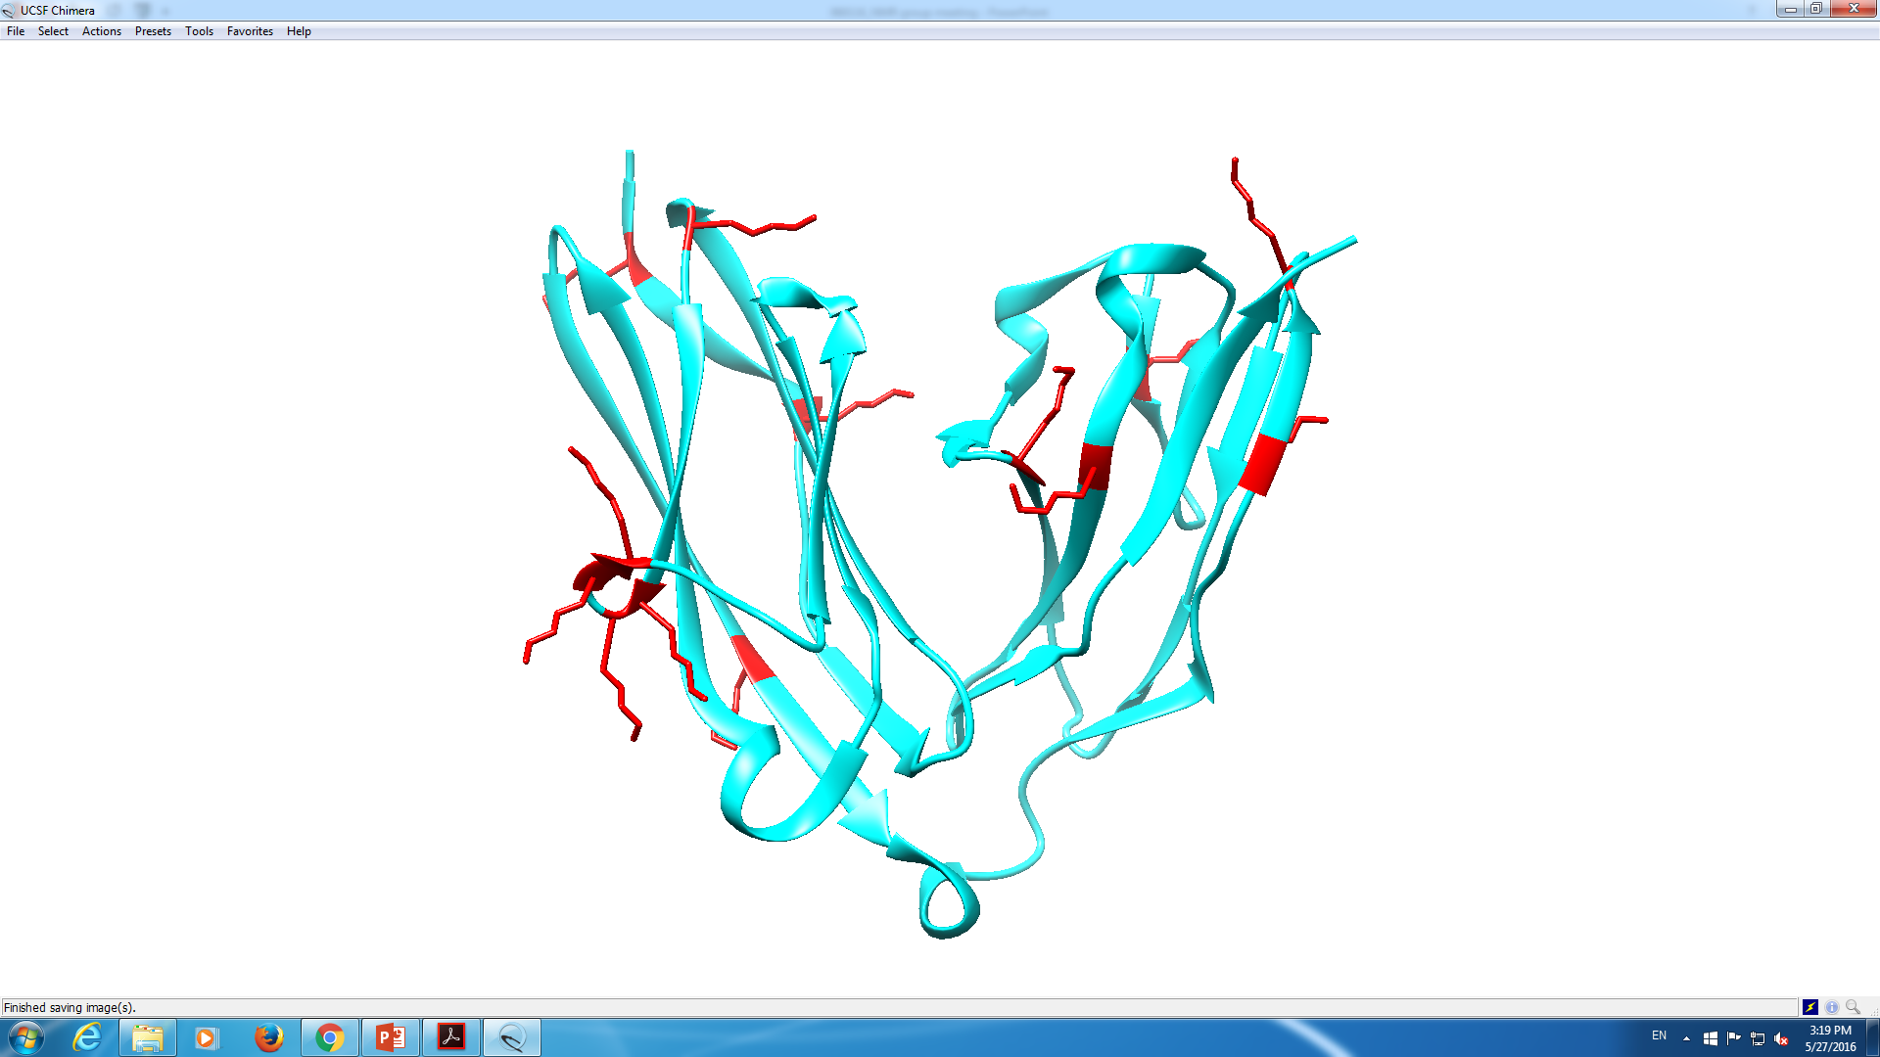
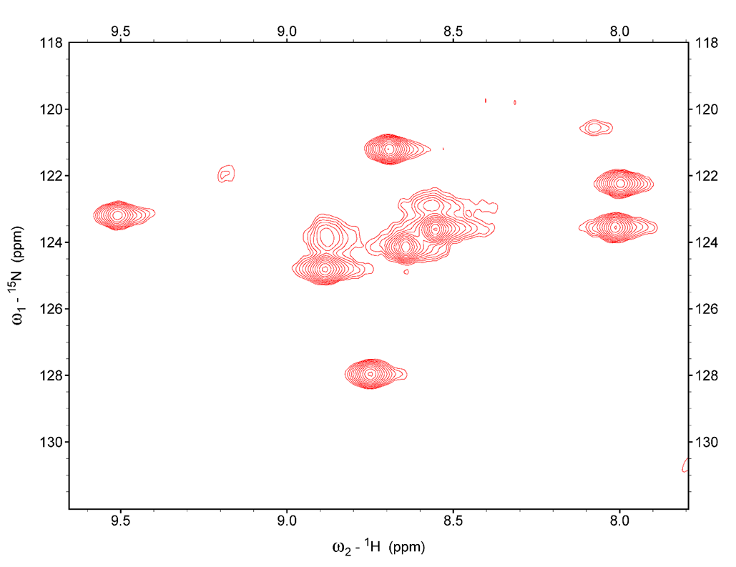
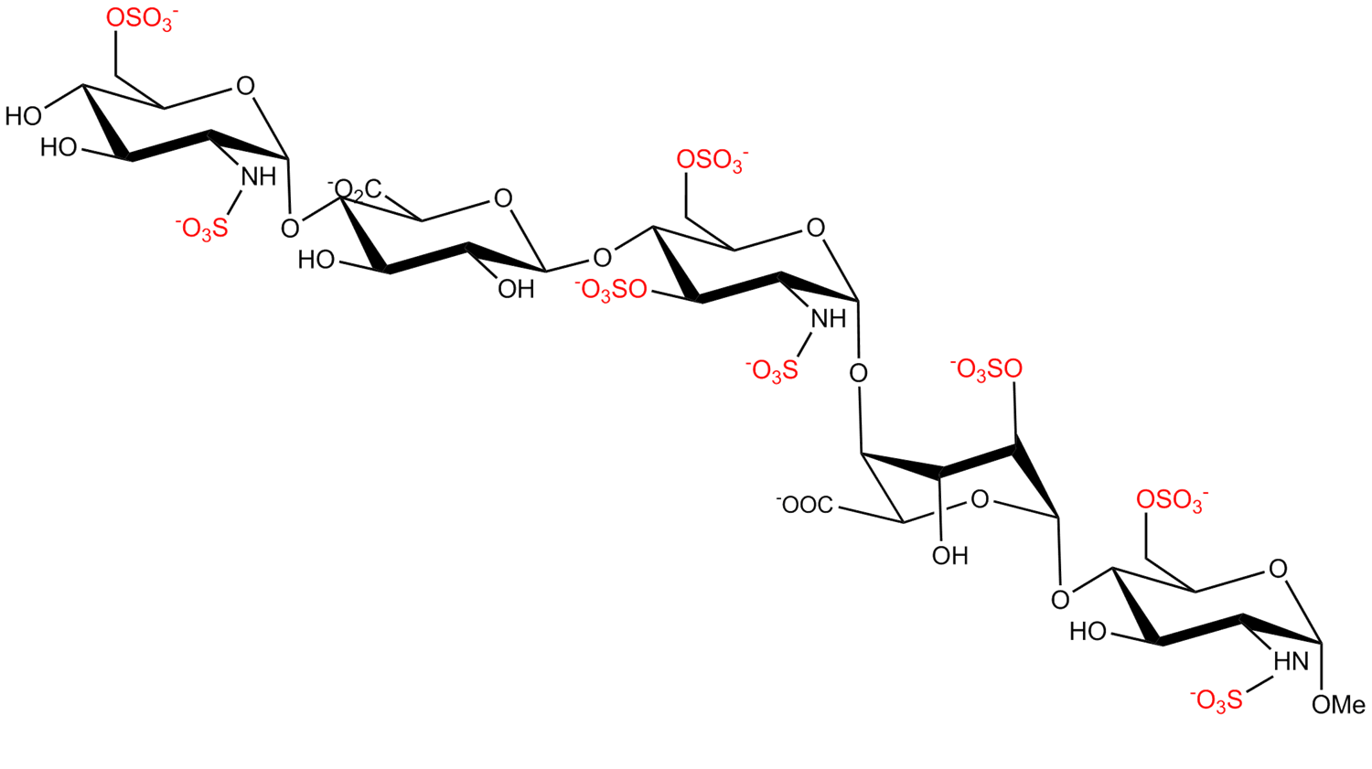
Protein and Ligand Materials
LAR-Ig1-2
PDB : 2YD5 Lys labeled in red
HSQC of ¹⁵N-Lys Labeled LAR
Fondaparinux (Arixtra)
Synthetic HS pentasaccharide
Anticoagulant medication
Highly sulfated heparan sulfate
Diverse sulfation pattern
A
B
C
D
E
7
Notes:
In this project, our aim is to present a solution model for the first two extracellular immunoglobulin-like domains of LAR (LAR-Ig1-2) and their interaction with a specific HS pentasaccharide chain (GlcNS6S-GlcA-GlcNS3, 6S-IdoA2S-GlcNS6S-OME, trade name fondaparinux). In this case, we also sparsely labeled lys residues for its high possibility involved in a GAG binding event. Fondaparinux, or Arixtra, is a synthetic HS pentasaccharid. It is used as an anticoagulant medication. There are diverse sulfation patterns in fondaparinux, including a rare 3-O-sulfate on the middle GlcNAc.
<number>

Slide 8
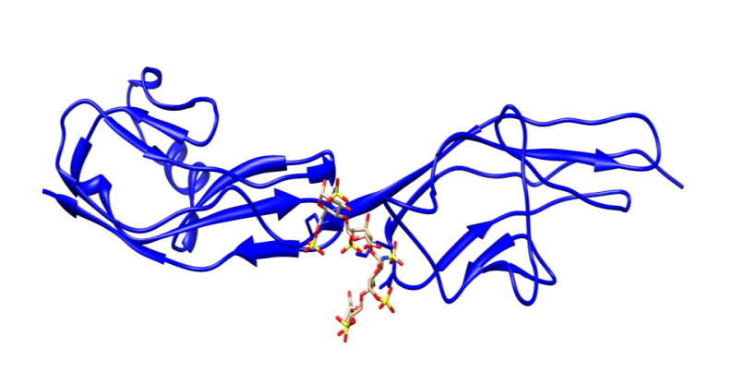
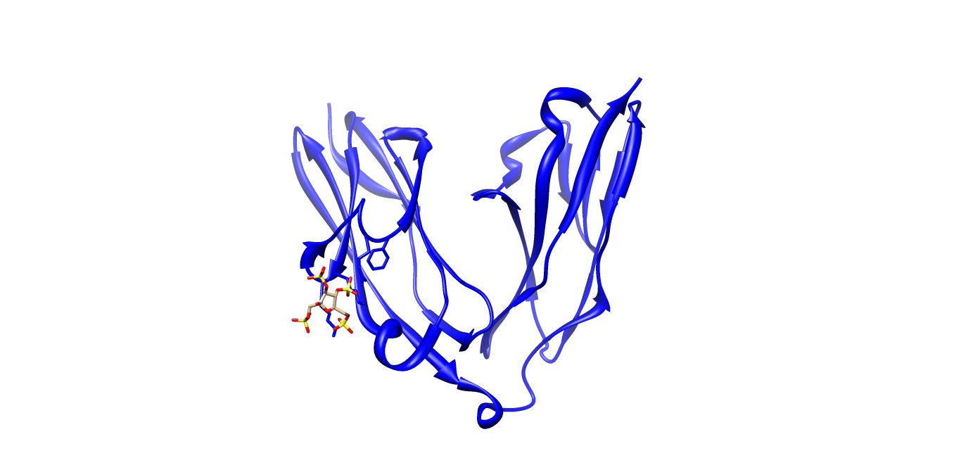
Examples of Signaling Glycoproteins
Robo1
LAR
GAGs
GAGs
Ig domains
Ig domains
Robo1, Ig1-2, PDB 2VRA
FN domains
FN domains
Cell membrane
Cell membrane
Phosphatase domains
Structure Similarities:
Mammalian protein
Containing several Ig-like domains which are N-glycosylated
Having inter-domain motions
Binding glycan ligand
LAR, Ig 1-2, PDB 2YD8
8
Notes:
Here are some examples of glycosylated mammalian signaling proteins. They are Roundabout 1( Robo1) leukocyte common antigen-related protein (LAR). These proteins share some structure similarities: the extracellular region begins with one or more immunoglobulin-like (Ig-like) domains which are highly glycosylated, followed by zero to several fibronectin type III (FN3) repeats, a transmembrane domain, and a cytoplasmic domain which conveys the signal to intracellular systems. The signaling pathways begin with interactions between the glycosylated terminal domains of these proteins and other molecules – under these two cases, are glycosaminoglycans: Robo1-GAG(HS), LAR-GAG(HS & CS).
<number>

Slide 9
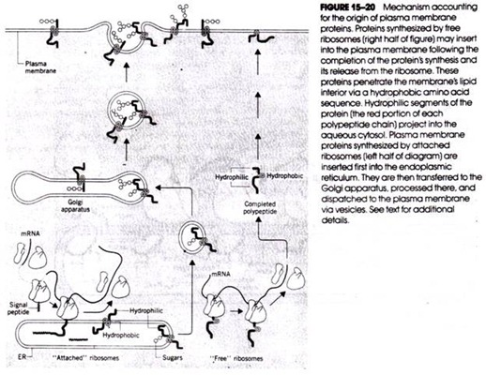

Slide 10
Goal
Structure determination of the LAR fondaparanix complex.
Measurements of the following -> HADDOCK to determine binding model
HSQC crosspeak assignments of sparsely labeled LAR fondaparinux, in the Ig1-2
Binding site determination using NMR titration
Ligand binding epitopes from saturation transfer difference NMR
Interdomain geometry, i.e. folding
Conformation of bound ring ligand using transfer NOE compared with unbound
Oligomerization state calculated from rotational correlation times
Modeling of the complex using HADDOCK
Free energy calculation using MM-GBSA to identify regions of high binding

Slide 11
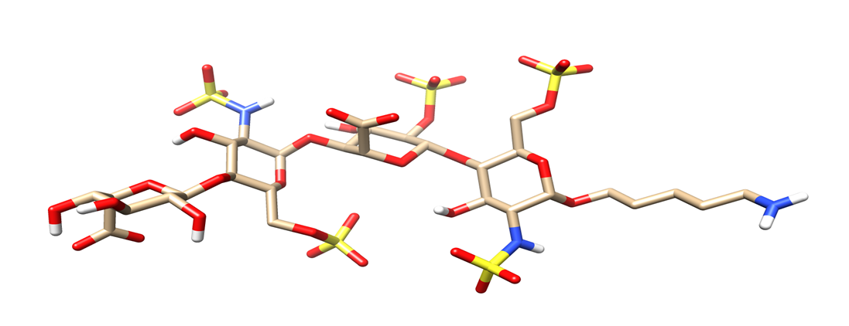
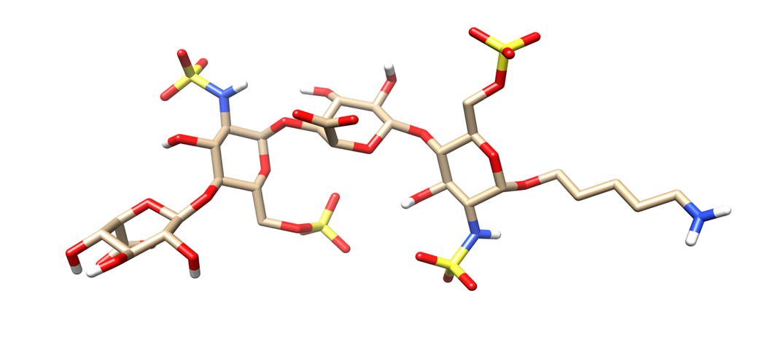
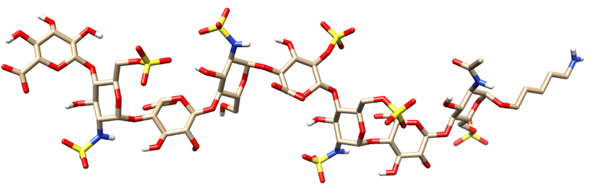
Ligand Binding Analysis
Chemical Shift Perturbation
Protein binding sites and dissociation constant determination
Ligand 1: IdoA-GlcNS6S-IdoA2S-GlcNS6S-(CH₂)₅NH₂
Saturation Transfer Difference
Ligand binding sites determination
Ligand 2: IdoA-GlcNS6S-IdoA-GlcNS6S-(CH₂)₅NH₂
Transferred NOEs
Conformation change determination
Ligand 3: GlcA-GlcNS6S-IdoA-GlcNS-IdoA2S
-GlcNS6S-IdoA-GlcNAc6S-(CH₂)₅NH₂
Paramagnetic Effects
Extra conformation and orientation binding information
Proteins are provide by Dr. Moremen’s group.
Ligands are synthesized by Dr. Boons’s group.
10
Notes:
After knowing the protein, let us take a look at the ligands in this study.
<number>

Slide 12
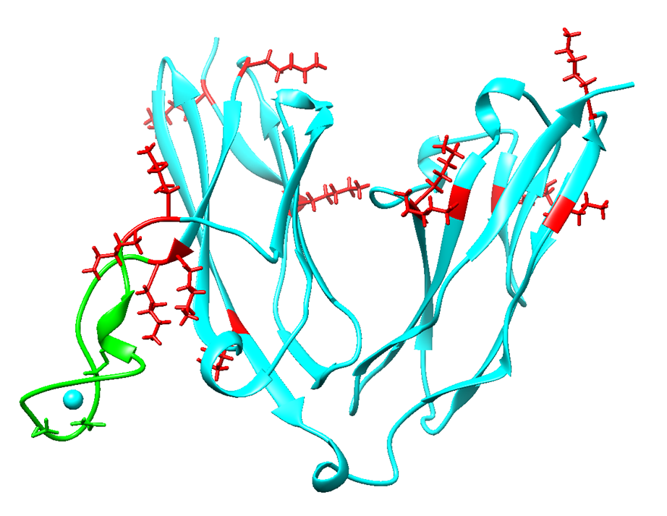
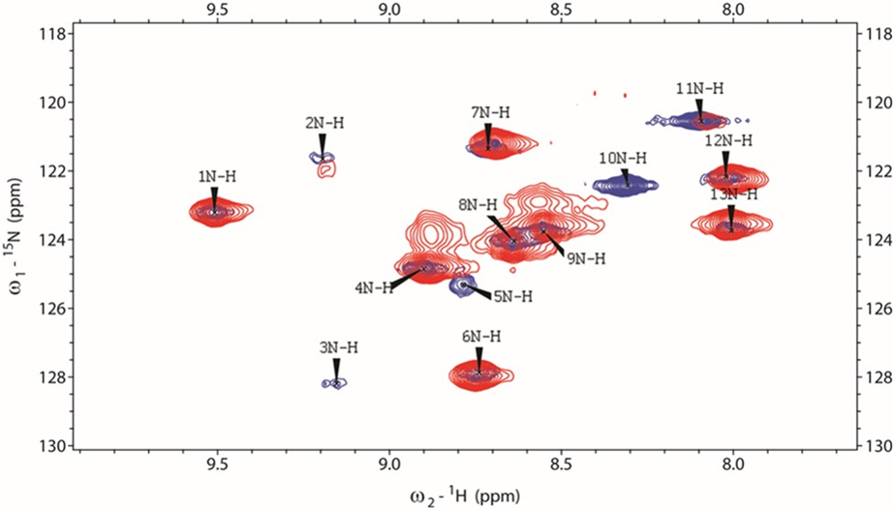
Assignment of LAR HSQC Crosspeaks
Lanthanide binding loop insertion
Increase resolution in indirect dimension
Facilitate NOE measurements
Benefit from paramagnetic effects
Loop sequence:
SYIDTNNDGAYEGDELSG
2D ¹⁵N-¹H HSQC spectra of (red) ¹⁵N Lys labeled LAR and (blue) ¹⁵N Lys labeled LAR-loop.
12
Notes:
So the next question coming along is: what are these perturbed peaks? At this time, this question would not be a hard one because we have a developed assignment strategy! In order to improve crosspeak assignments, we insert a lanthanide binding loop into the LAR construct. This loop contains 18 amino acids. The HSQC spectrum of lys labeled LAR-loop is labeled in blue and it is overlaid with the native LAR which is labeled in red. Most of the crosspeak positions are preserved and it means that the loop insertion does not affect the basic structural features of LAR. Positions of crosspeak 5 and 10 are changed due to the change of local structural nearby these residues. With the help of this loop, the HSQC resolution in the indirect dimension is increased. This dispersion is particularly critical for collection of subsequent ¹⁵N-filtered NOESY. Most importantly, the assignments will benefit from the paramagnetic effects of lanthanide.
<number>

Slide 13
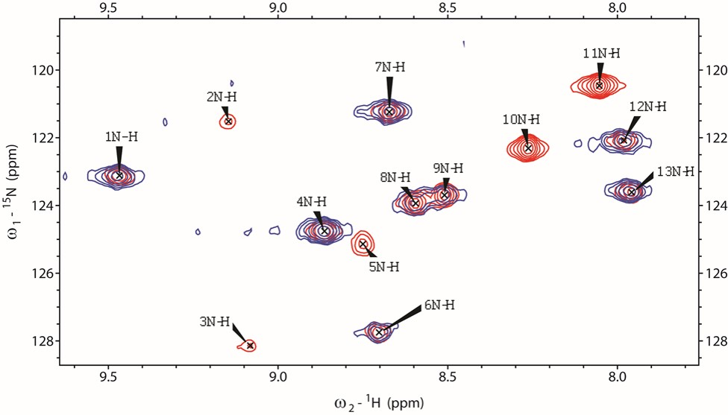
Assignment of LAR HSQC Crosspeaks
5 crosspeaks decrease intensity the most: 2, 3, 5, 10 and 11
A 1 μs MD of LAR-loop is conducted
5 Lys sites are close to the metal: K68, K69, K71, K72 and K121
Design ASSIGN_SLP penalties
Superposition of ¹⁵N-¹H HSQC spectra of ¹⁵N-Lys labeled LAR-Ig1-2-loop(red), engineered with lanthanide binding peptide loaded with Gd³⁺ (blue)
13
Notes:
When we load paramagnetic lanthanide Gd3+ with LAR-loop, the lysine sites close to the metal with suffered from paramagnetic perturbation and decrease its cross peak intensity. From the overlaid spectra we can tell that the intensities of crosspeaks 2, 3 5, 10 and 11 decrease the most; this indicates these residues to be the closest in distance to the lanthanide. By comparing the distances from a MD simulation, the 5 residues nearest the ion belong to K68, K69, K71, K72 and K121. This fact will help us separate residues into two groups, a close metal group and a far metal group. The data degeneracy is gonna decrease so that the assignment will be more robust.
<number>

Slide 14
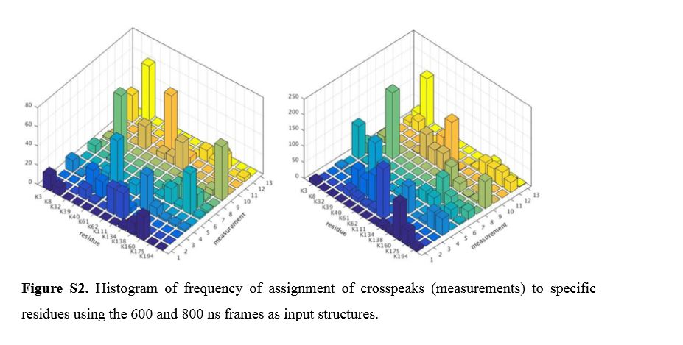
Probability figure

Slide 15
Assignment of LAR HSQC Crosspeaks
Assignments summary of ¹⁵N-Lys LAR-loop
Crosspeak | 600 ns | 800 ns | 1000 ns | Assignment summary
1 | K160 | K160 | K160,K134 | K134(144)
2 | K62,K111 | K111 | K111* | K111(121)
3 | K39,K62 | K61,K40 | K40* | K40(69)
4 | K134* | K134 | K3,K175 | K3(32)
5 | K40 | K39 | K39 | K39(68)
6 | K175* | K3 | K175 | K175(185)
7 | K160,K175,K138 | K138 | K160 | K160(170)
8 | K32 | K32* | K32* | K32(61)
9 | K194* | K194 | K194,K3 | K194(204)
10 | K111,K39 | K40,K62 | K62,K40 | K62(72)
11 | K61* | K62 | K61* | K61(71)
12 | K3,K160 | K8,K138 | K8* | K8(37)
13 | K8* | K8* | K138* | K138(148)
Protein binding sites:
K68, K69, K71 and K72.
*Assignment frequency is higher than half of the total assignments. The residue number corresponding to the crystal structure number is listed in parentheses.
15
Notes:
The assignments are summarized using 3 different MD frames as input protein structures in the program. The assignments with a frequency higher than 50% of the total assignments are labeled with an asterisk. Other assignments represent the most frequent assignment. Multiple residues are listed when the frequencies of assignment to multiple residues are similar. In the end, the crosspeaks showing the most perturbation in the titration experiments are assigned to lys 69, 68 , 72 and 71. These four residues are defined as direct protein binding sites.
<number>

Slide 16
Where is protein binding site?
Chemical shift perturbation
Binding site determination
Perturbed sites: crosspeak 3, 5, 10, 11
Every 50 \mu M
7
11
10
12
2
5
1
8
9
13
4
3
6
HSQC spectra of LAR with increasing concentration of fondaparinux from 0 μM to 550 μM with rainbow colors coded.
16
Notes:
Four residues, belonging to peaks 3,5,10 and 11, display substantial chemical shift perturbation (> 0.05 ppm) upon the titration with fondaparinux. Fitting the average of the shifts for these peaks, a disassociation constant (Kd) of 60 ± 24 μM is determined. This is a moderately high affinity, well within the range of dissociation constants found for Robo1 interactions with HS oligomers (see chapter 2).
<number>

Slide 17
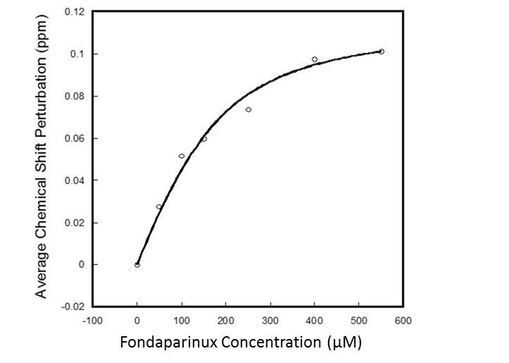
LAR-Fondaparinux Binding Affinity
Chemical Shift Perturbation (ppm)
K_{d} = 60 ± 24 μM
Lys HSQC peak number
Total chemical shift perturbation of each Lys residue is plotted against the crosspeak number.
Binding affinity of LAR-Ig1-2 for the HS fondaparinux.
17
Notes:
Fitting the average of the shifts for these peaks, a disassociation constant (Kd) of 60 ± 24 μM is determined. This is a moderately high affinity, well within the range of dissociation constants found for Robo1 interactions with HS oligomers.
<number>

Slide 18
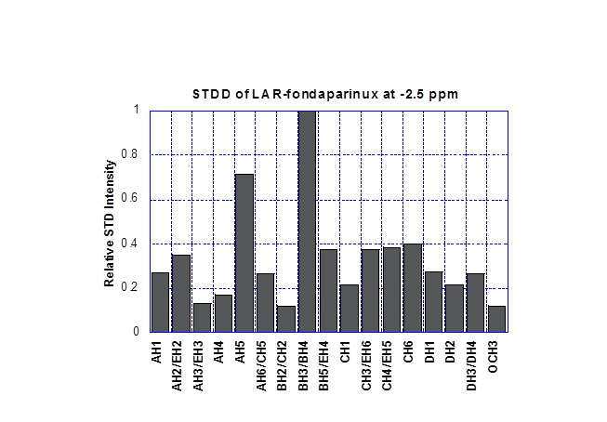
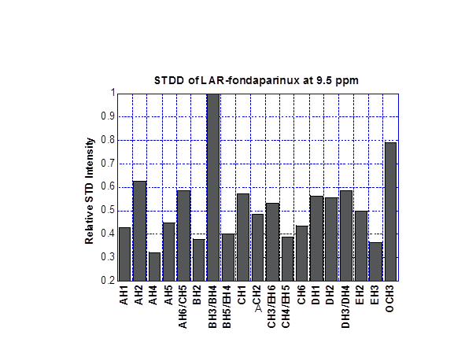
STD identifies interaction epitopes on the ligands
Saturation Transfer Difference:
Identify potential interaction epitopes on the ligands
Saturation of magnetization of a protein proton is transferred to a proton on the ligand in a distance dependent way
Largest STD: BH3/BH4, some parts of A and C
Complexities:
Spin-spin relaxation filter not effective for glycoproteins
Significant spin-diffusion
<number>
Notes:
Saturation transfer difference (STD) experiments can help identify potential interaction epitopes on the ligands. saturation of magnetization of a particular proton on the protein is transferred to a proton on the ligand in a 1/r^6 dependent way, and a ligand resonance with a close approach to a protein proton will decrease in intensity, identifying it as a part of the binding epitope on the ligand. A difference spectrum collected with and without saturation leaves primarily ligand resonances experiencing this transfer. The largest STD intensity losses come from BH3/BH4, and some parts of the A (AH2 and AH5) and C (CH1, CH3 and CH5) residues. These results indicate that these three residues are most proximate to the protein surfaceThere are, however, there are some complexities of glycoproteins. Usually a spin-spin relaxation filter is used to remove the broad protein resonances. For a glycoprotein, resonances from the attached glycan are not broad and persist in the difference spectrum at positions that often overlap with those of our ligand. Therefore, a double difference spectrum was produced using an STD spectrum acquired on the protein in the absence of ligand. Most other protons show significant signals, suggesting a significant spin diffusion among ligand protons. Thus we will confine our use to the three protons mentioned above.
<number>

Slide 19
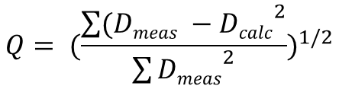
Inter-domain Orientation Determination by RDC
Protein orientation geometry can be validated from RDC data.
Q factor:
Crystal structure of LAR-Ig1-2
LAR-Ig1-2 model based on Robo1 (pdb 2v9r). LAR Ig1 is in beige, Ig2 is in pink and Robo Ig1-2 is in blue.
 | Crystal Structure | Straight Model
Q Factor | 0.19 | 0.43
<number>
Notes:
In addition to defining the binding sites location, these assignments can also help us asses the validity of the domain geometry directly by looking at Q factors for RDC data. Q factors are ratios of RMSD of measured and calculated RDCs and the RMS of the measurements. A Q factor of 0.4 has been suggested to reflect a structure comparable to an X-ray structure of approximately 2.5 Å resolution. We get a Q factors of 0.19, indicating that LAR structure is preserved in solution. , because the Ig1-2 domains of LAR are structurally similar to the Ig1-2 domains of Robo1, so as a comparison, we also built a more straight model of LAR, using one of the Robo1 structure as a template. The Q factor decrease to 0.5, which indicate that RDC is very sensitive to inter-domain geometry and the crystal structure of LAR also represents its structure in solution.
<number>

Slide 20
HS conformation changes are reflected from trNOE
Transferred NOE:
Conformation of the HS when bound to LAR can be determined.
By integrating the volume of the trNOE cross peaks, inter proton distances can be derived.
¹C₄-chair for IdoA2S
Nuclei pair | Free ligand (Å) | Error (Å) | trNOE (Å) | Error (Å)
AH1-BH4 | 2.62 | 0.02 | 2.86 | 0.21
CH1-DH4 | 2.41 | 0.02 | 2.65 | 0.20
CH3-DH1 | 2.43 | 0.11 | 3.05 | 0.25
DH1-DH2 | 3.16 | 0.01 | N/A | N/A
DH1-DH3 | 3.27 | 0.01 | 2.72 | 0.19
DH1-EH4 | 2.71 | 0.02 | 3.14 | 0.25
DH1-EH61 | 2.85 | 0.02 | 2.91 | 0.23
DH1-EH62 | 3.22 | 0.03 | 2.49 | 0.19
Linker H-EH1 | 2.96 | 0.02 | 3.22 | 0.20
Experiment done at crossover point in which noe’s go from positive to negative
No contribution from unbound ligand
A
B
C
D
E
²S₀-skew boat for IdoA2S
A
B
C
D
E
Interproton distances of fondaparinux derived in free and bound states from NOE data
<number>
Notes:
The transferred nuclear Overhauser effect (trNOE) is a powerful NMR phenomenon to study protein-bound ligand conformations. The rotational correlation time of the ligand in the bound state is longer than that in the free state. By integrating the volume of the trNOE cross peaks, inter proton distances can be derived, so the conformation of the HS when bound to LAR can be determined.
There are some differences between the fondaparinux interproton distances converted from NOEs measured in a free state and the distances converted from trNOE measurements dominated by the bound state. For instance, the measurable transglycosidic distances between CH3 and DH1 are 0.62 Å longer in the bound state (3.05 Å) than that in the free state 2.43 Å. Similarly, a trNOE observed between DH1 and EH4 gives a calculated distance of 3.14 Å, which is also significantly longer than the free state distance (2.71 Å). These two trNOE distances measured from a bound fondaparinux suggest it adopts a preferred conformation which is different from the dominant free state conformation, particularly with respect to the glycosidic linkages between GlcNS3,6S C and IdoA2S D, and IdoA2S D and GlcNS6S E. Besides the transglycosidic distance, another piece of useful information comes from distances between protons on the IdoA2S ring. The distance between IdoA2S D H1 and H2 and D H1 and D H3 are 3.16 Å and 3.27 Å respectively in the free state. These suggest a mixture of a 1C4 chair and 2S0 skew-boat conformation. The skew-boat conformation is known to be particularly favorable in solution when a 3-O-sulfate is attached to the preceding GlcNAc residue40. A trNOE between IdoA2S D H1 and H3 in the bound state gives a 2.72 Å distance, which is shorter than that of the free state (3.27 Å), indicating a much higher population of the skew-boat conformer
<number>

Slide 21
Will HS binding induce LAR oligomerization?
Molecular weight can be calculated from rotational correlation time
Previous studies: HS will induce RPTP σ oligomerization
Τc (ns) = 0.5 × MW (KDa)
Table. Rotational correlation time τc of Lys residues in LAR in the presence of fondaparinux.
Crosspeak | 1 | 2 | 3 | 4 | 5 | 6 | 7 | 8 | 9 | 10 | 11 | 12 | 13
TauC (ns) | 8.6 | 8.2 | 5.8 | 7.8 | 11.6 | 9.9 | 9.1 | 7.3 | 8.7 | 7.2 | 7.0 | 10.1 | 8.4
Assignment | K144 | K121 | K69 | K32 | K68 | K185 | K170 | K61 | K204 | K72 | K71 | K37 | K148
Average TauC | 8.4 ns
LAR-fondaparinux complex: MONOMER
<number>
Notes:
After obtaining a complex model, here is the last question: under the current experimental condition, will HS binding induce LAR oligomerization? It can be answered by knowing the molecular weight of the complex. In NMR, the molecular weight of a molecule can be calculated from the rotational correlation time. It is the time it takes the particle to rotate by one radian and it depends on the particle size. For globular proteins a spherical approximation can be used and the rotational correlation time is given by Stoke's law. As a general rule of thumb, the τ_{c} of a protein in solution in nanoseconds is approximately 0.5 times its molecular weight in kDa. The molecular weight of LAR is 22KDa giving an estimated τc of 11ns for monomer and 22ns for dimeric state. The measured average Tc of LAR-fondaparinux is 8.41 ns, indicating it is still a monomer in solution.
<number>

Slide 22
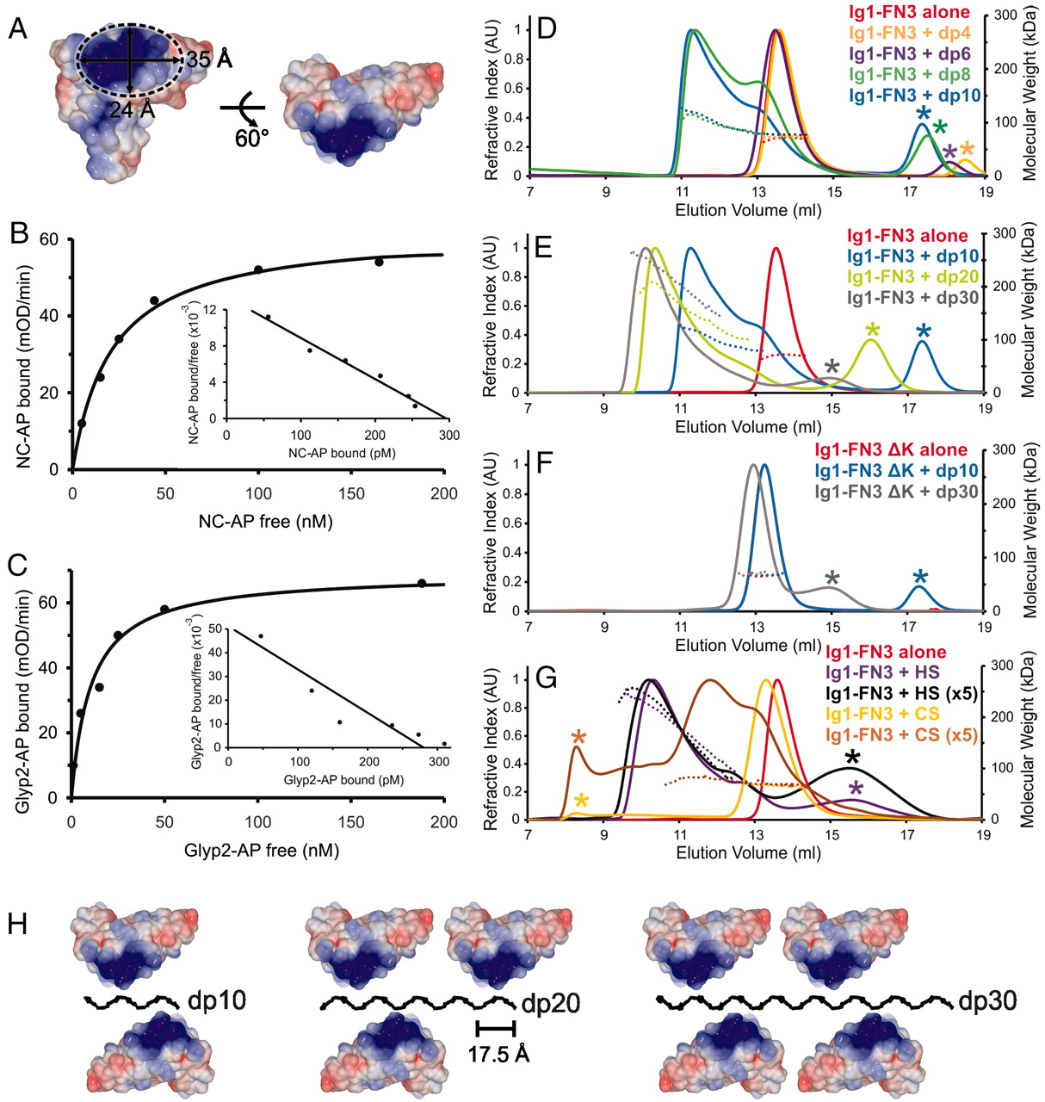
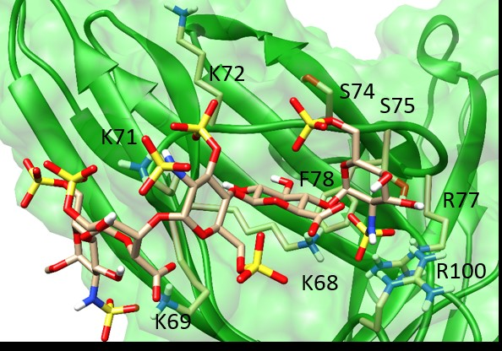
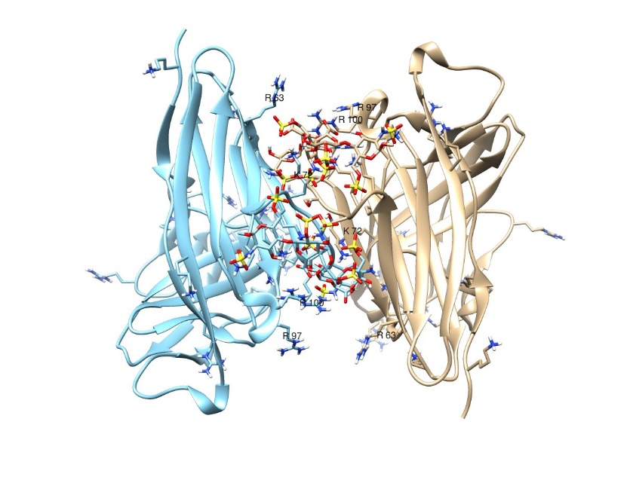
LAR-HS Oligomerization Model
Coles, C. H., et al. (2011). Science 332(6028): 484-488.
Molecule A
Molecule B
Heparan Sulfate vs Chondroitin Sulfate
HS octamer
CS E octamer
<number>
Notes:
This doesn’t mean that longer HS oligomers couldn’t induce aggregation. The results from previous research on RPTP σ binding with depolymerized heparin showed that dp8 was the minimum length to assemble RPTP σ oligomers. Examine our model, we could see that several sulfates are not interacting with protein residues, but leave in solution. These sulfates are more likely to interact we another protein molecule. Based on these information, we built a potential 2:2 dimer complex. A longer HS oligomers could very possible induce a LAR oligomerization. Comparing the structure features of HS and CS, we can find that the sulfates of HS locates at both side of the sugar rings therefore are able to contact with proteins residues on both side. While most of the sulfates on CS sit on one side of sugar rings. This could be a reason why HS can induce LAR oligomerzation but CS cannot.
<number>

Slide 23
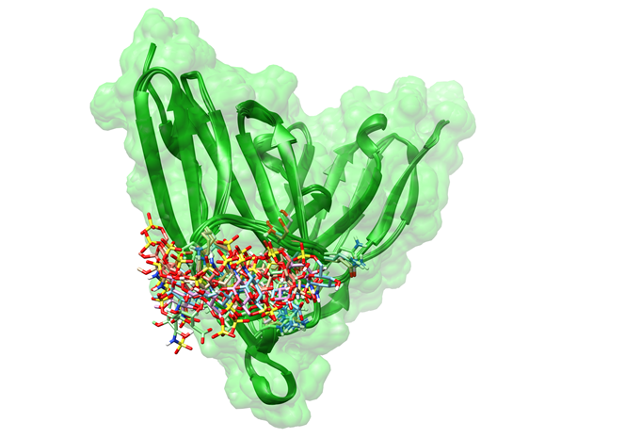
LAR-Fondaparinux Docking Results
TOP 5 structures
Same binding pocket
Structure differences: IdoA2S (D) and GlcNS6S (E)
Expanded structure
5 Å contact : K68,K69,K71,K72,S74,S75,F78,R77 and R100
1 Å contact: K68, K69 and R77
Top 5 HADDOCK structures with the highest score and lowest energy for the LAR-fondaparinux complex
Expanded view of the binding pocket for the LAR-fondaparinux HADDOCK structure.
<number>
Notes:
The top 5 structures with lowest HADDOCK score, energy as well as smallest rms NOE violations are presented in figure on the left. Comparing the top docked structures, we find that most of the structure differences arise from the last two sugars (IdoA2S and the reducing end GlcNS6S, residues D and E). These interact with multiple lysines on the binding loop, taking advantage of the motional freedom of these residues. Expanded view of the binding pocket for the LAR-fondaparinux HADDOCK structure is list on the right. Nearby interacting residues are shown as stick structures and labeled
<number>

Slide 24
Binding Energy Contributions Analysis
Binding affinities = Lysine + sulfates electrostatic?
Table. Per-residue free energy decomposition of fondaparinux by MM-GBSA
 | van der Waals (kcal/mol) | Electrostatic (kcal/mol) | Polar Solvation (kcal/mol) | Non-polar Solv (kcal/mol) | TOTAL (kcal/mol)
GlcNS6S E | -1.1 | -25.3 | 27.9 | -0.2 | 1.3
Ido2S D | -0.6 | -95.3 | 87.7 | -0.2 | -8.5
GlcNS3,6S C | -1.8 | -85.8 | 87.9 | -0.2 | 0.1
GlcA B | -2.1 | -54.3 | 57.1 | -0.3 | 0.3
GlcNS6S A | -3.7 | -81.4 | 78.3 | -1.0 | -7.8
6-O-sulfate A | -0.4 | -17.4 | 19.1 | -0.1 | 1.2
6-O-sulfate C | -0.2 | -31.2 | 31.8 | -0.0 | 0.3
3-O-sulfate C | -0.1 | -87.5 | 82.9 | -0.4 | -5.1
2-O-sulfate D | -0.6 | -47.1 | 49.0 | -0.2 | 1.2
6-O-sulfate E | -0.2 | -12.3 | 13.3 | -0.1 | 0.7
<number>
Notes:
It is tempting to focus on the electrostatic interactions as the primary origin of binding affinities and ascribe particular importance to the K residues and sulfations interaction because of the pronounced change in chemical shift of the crosspeaks. However, one must remember that electrostatic interactions with other polar groups as well as van der Waals terms contribute, and that affinities are the result of differences in energies of interaction in the complex, and interactions of separated protein and ligand with solvent. Molecular mechanics-generalized Born surface area (MM-GBSA) calculations provide one way of looking at affinities with a broader perspective. We preformed these calculations on the top 3 docked structures, excluding conformational entropy terms. A per-residue decomposition was performed, treating the 2-O-sulfate 3-o-sulfate and 6-O-sulfates as separate residues so their contributions could be explicitly examined. Among the 5 decomposed sulfates in fondaparinux , only the 3-O-sulfate on the middle GlcNS3,6S shows an average favorable total energy -5.1cal/mol. All of the other sulfates, although having very large electrostatic contributions, have this more than offset by a higher desolvation penalty. Among the residual sugar rings, only the IdoA and non-reducing end GlcNAc consistently shows a favorable energy of interaction. This could of course result from a distortion caused by the unusual concentration of charge around the central GlcNAc; 3-O-sulfation is actually rare in native HS. This analysis does emphasize the importance of considering all interactions, both in complexed and free states, before ascribing importance to any single aspect of a structural model. And it also suggests that fondaparinux may not be an ideally favorable ligand to interact with LAR.
<number>

Slide 25
Conclusions
Characterization of LAR-Ig1-2
Demonstration of ligand binding analysis
Use of the assign_slp package and how assignments can be used

